Slide 1

Geometry
Unit 12, Lesson 2 Solving Problems with Lengths of Two Secants Volume 2, pg. 237

Slide 2


Benchmark
MA.912.GR.6.1
Solve mathematical and real-world problems involving the length of a secant, tangent, segment, or chord in a given circle.
volume 2, pg. 237

Slide 3
Integrated Mathematical Thinking and Reasoning Standards
MA.K12.MTR.1.1 Actively participate in effortful learning both individually and collectively.
MA.K12.MTR.2.1 Demonstrate understanding by representing problems in multiple ways.
MA.K12.MTR.4.1 Engage in discussions that reflect on the mathematical thinking of self and others.
MA.K12.MTR.5.1 Use patterns and structure to help understand and connect mathematical concepts.
MA.K12.MTR.6.1 Assess the reasonableness of solutions.
MA.K12.MTR.7.1 Apply mathematics to real-world contexts.
volume 2, pg. 237

Slide 4

Learning Target
I can solve mathematical and real-world problems that involve the lengths formed by the intersection of two secants.
volume 2, pg. 237

Slide 5

Warm-Up
volume 2, pg. 238

Slide 6
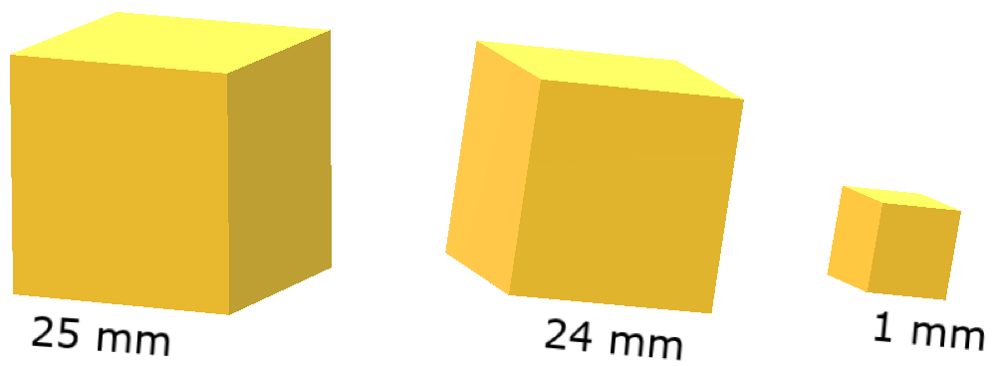
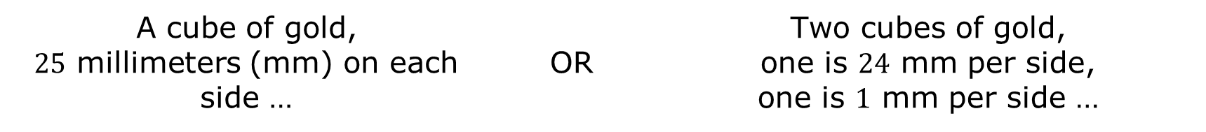
12.2.1 Warm-Up: Would You Rather?
Would you rather have …
Explain your choice.
A cube of gold, $25$ millimeters (mm) on each side … | OR | Two cubes of gold, one is $24$ mm per side, one is $1$ mm per side …
volume 2, pg. 238

Slide 7

Exploration
volume 2, pg. 238

Slide 8

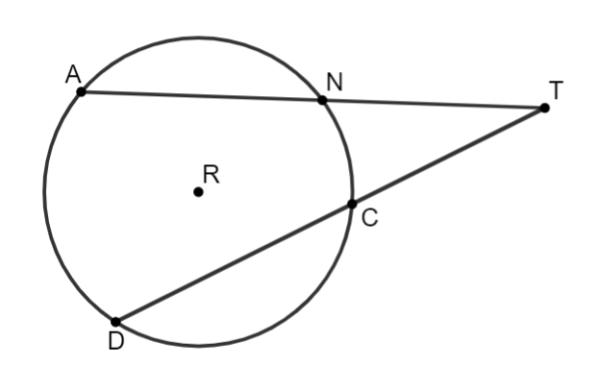
12.2.2 Exploration: Intersecting Secant Lengths
A secant is a line that passes through two points on a circle. In the interior of the circle, a secant line forms a chord.
Circle $R$ is shown with points $A$, $N$, $D$, and $C$ on the circle. Secants $\overline{AT}$ and $\overline{DT}$ intersect at point $T$ outside the circle. $AN=6$, $CD=9$, $NT=8$, and $CT=7$.
volume 2, pg. 238

Slide 9
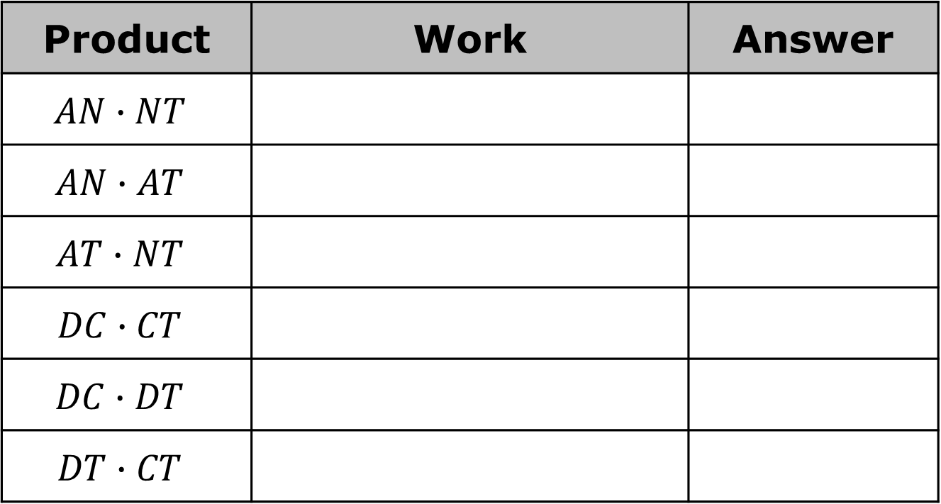
Complete the table.
Product | Work | Answer
$$AN∙NT$$
$$AN∙AT$$
$$AT∙NT$$
$$DC∙CT$$
$$DC∙DT$$
$$DT∙CT$$
volume 2, pg. 238

Slide 10
Discuss the following with your partner.
What do you notice about your answers?
What do you notice about the secant segments for the rows that have the same answer?
volume 2, pg. 239

Slide 11
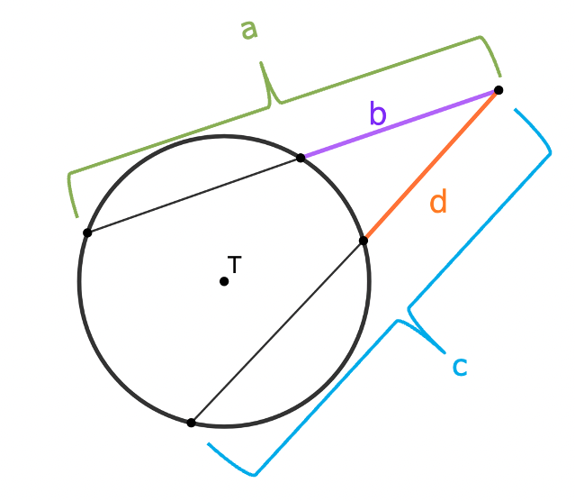

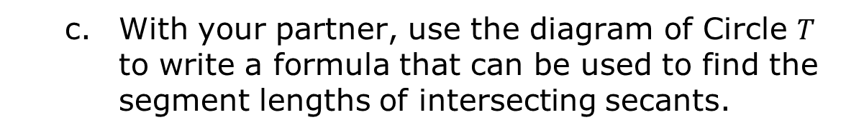
With your partner, use the diagram of Circle $T$ to write a formula that can be used to find the segment lengths of intersecting secants.
If two secants intersect outside a circle, then the product of the lengths of one secant segment and its external secant segment equals the product of the lengths of the other secant segment and its external secant segment.
volume 2, pg. 239

Slide 12

Guided Practice
volume 2, pg. 239

Slide 13

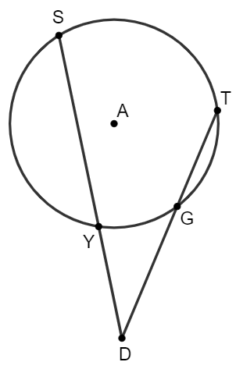
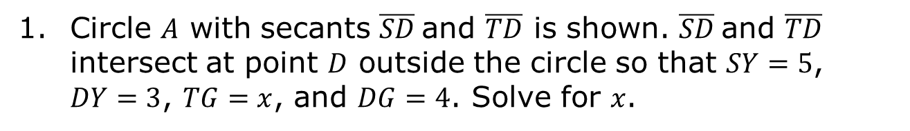
12.2.3 Guided Practice: Solving Problems Involving Intersecting Secant Lengths
Circle $A$ with secants $\overline{SD}$and $\overline{TD}$ is shown. $\overline{SD}$and $\overline{TD}$ intersect at point $D$ outside the circle so that $SY=5$, $DY=3$, $TG=x$, and $DG=4$. Solve for $x$.
volume 2, pg. 239

Slide 14
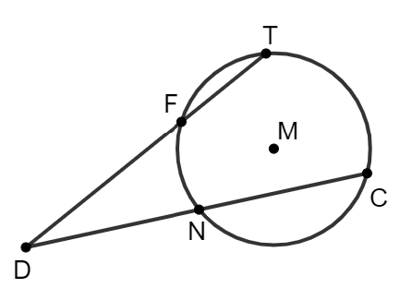
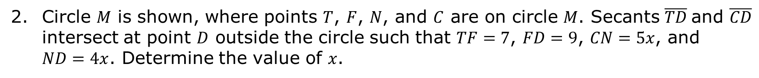
Circle $M$ is shown, where points $T$, $F$, $N$, and $C$ are on circle $M$. Secants $\overline{TD}$and $\overline{CD}$ intersect at point $D$ outside the circle such that $TF=7$, $FD=9$, $CN=5x$, and $ND=4x$. Determine the value of $x$.
volume 2, pg. 240

Slide 15
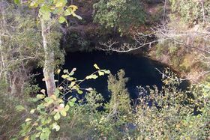
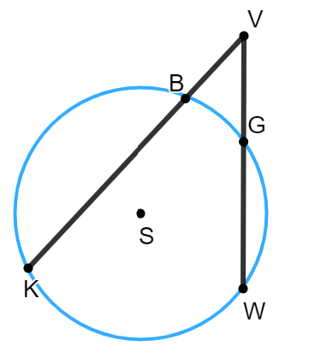
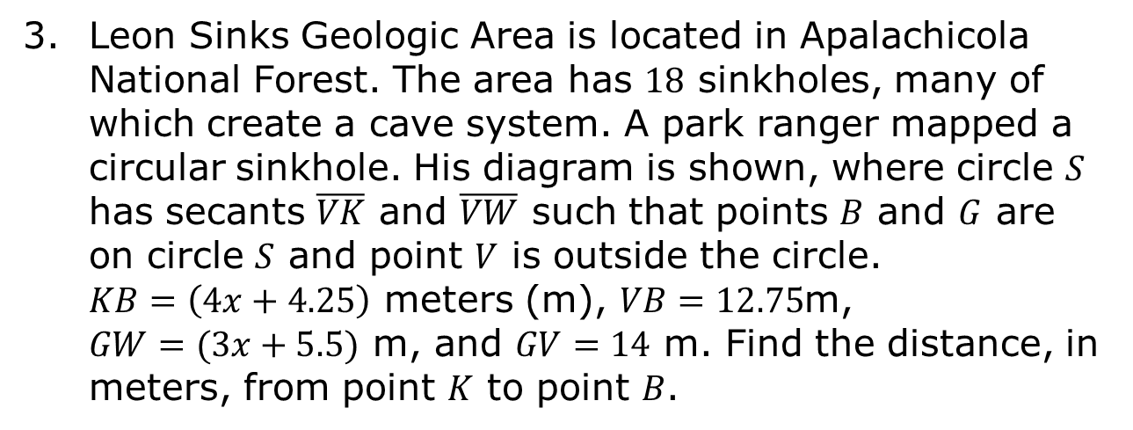
Leon Sinks Geologic Area is located in Apalachicola National Forest. The area has $18$ sinkholes, many of which create a cave system. A park ranger mapped a circular sinkhole. His diagram is shown, where circle $S$ has secants $\overline{VK}$ and $\overline{VW}$ such that points $B$ and $G$ are on circle $S$ and point $V$ is outside the circle. $KB=\left(4x+4.25\right)$ meters (m), $VB=12.75$m,
$GW=(3x+5.5)$ m, and $GV=14$ m. Find the distance, in meters, from point $K$ to point $B$.
volume 2, pg. 240

Slide 16

Your Turn
volume 2, pg. 241

Slide 17
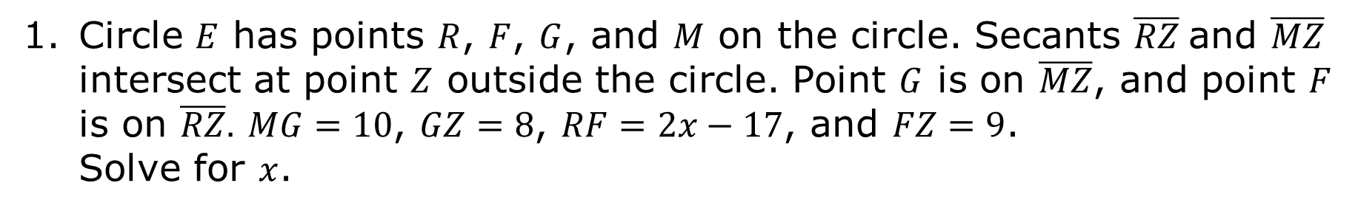
12.2.4 Your Turn!
Circle $E$ has points $R$, $F$, $G$, and $M$ on the circle. Secants $\overline{RZ}$and $\overline{MZ}$ intersect at point $Z$ outside the circle. Point $G$ is on $\overline{MZ}$, and point $F$ is on $\overline{RZ}.$ $MG=10$, $GZ=8$, $RF=2x−17$, and $FZ=9$. Solve for $x$.
volume 2, pg. 241

Slide 18
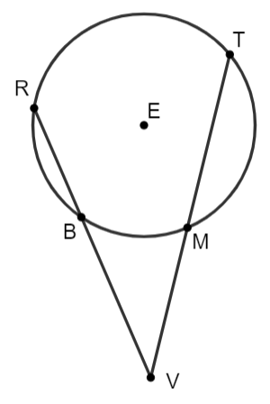
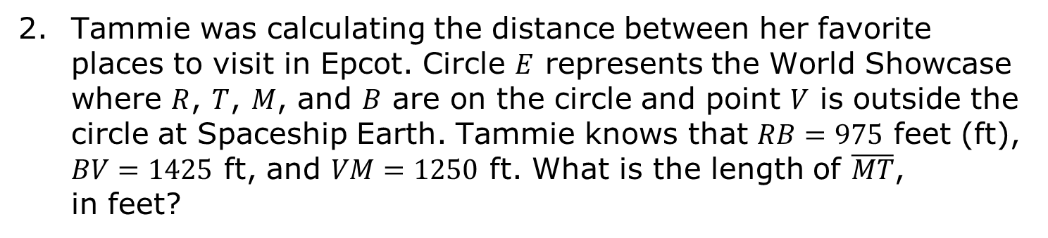
Tammie was calculating the distance between her favorite places to visit in Epcot. Circle $E$ represents the World Showcase where $R$, $T$, $M$, and $B$ are on the circle and point $V$ is outside the circle at Spaceship Earth. Tammie knows that $RB=975$ feet (ft), $BV=1425$ ft, and $VM=1250$ ft. What is the length of $\overline{MT}$, in feet?
volume 2, pg. 241

Slide 19

Wrap-Up
volume 2, pg. 241

Slide 20
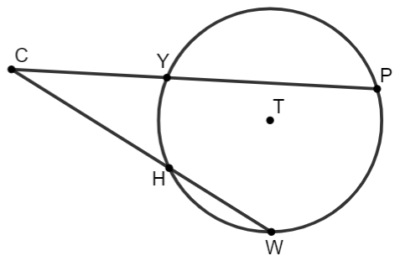
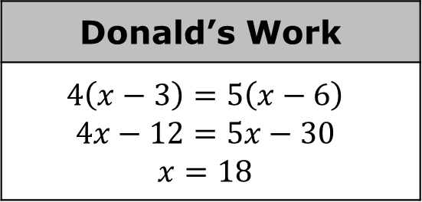

12.2.5 Wrap-Up: Error Analysis
Donald was finding the value of $x$ in circle $T$, where $Y$, $P$, $W$, and $H$ are points on the circle. He knows that $\overline{CP}$ and $\overline{CW}$ are secants of the circle, where $CY=4$, $YP=x−3$, $CH=5$, and $HW=x−6$. His work is shown.
Write a note to Donald explaining the mistake he made when solving for $x$.
Donald’s Work
$$4\left(x−3\right)=5\left(x−6\right)$$ $$4x−12=5x−30$$ $$x=18$$
volume 2, pg. 241

